Slide 1
“image3dresource: discrete”
“image3d: interpolated”
“image3d: normalized”
res_z
res_z
(1, 0, 0)
res_y
(res_x, res_y, 0)
(1, 0, 0)
RB GA
RB GA
RB GA
RB GA
RB GA
RB GA
RB GA
RB GA
0
RB GA
RB GA
RB GA
res_x
(0, 0, 0)
(1, 0, 0)
(0, 0, 0)
(res_x, 0, 0)
4 channels defined on half-integer coordinates.
Values are integers from 0 to 2^bitdepth - 1
1 channel defined the full space
Values are integers from 0 to 2^bitdepth - 1
1 channel defined the full space,
Values are normalized between minvalue and maxvalue.

Slide 2
“image3d: logical”
Image3dslice “logical”
(1,1,1)
RB GA
RB GA
RB GA
0 <= v <= 1
RB GA
RB GA
RB GA
0 <= u <= 1
0 <= w <= 1
R,B,G,A are double values in [0,1]
0 <= v <= 1
(0,0,0)
0 <= u <= 1

Slide 3
“image3dresource: discrete”
“image3d: interpolated”
“image3d: normalized”
res_z
res_z
(1, 0, 0)
res_y
(res_x, res_y, 0)
(1, 0, 0)
RB GA
RB GA
RB GA
RB GA
RB GA
RB GA
RB GA
RB GA
0
RB GA
RB GA
RB GA
res_x
(0, 0, 0)
(res_x, 0, 0)
(0, 0, 0)
(1, 0, 0)
image3dsheet “discrete”
image3dsheet “interpolated”
image3dsheet “normalized”
res_y
res_y
1
RB GA
RB GA
RB GA
RB GA
RB GA
RB GA
RB GA
RB GA
(0, 0, z)
RB GA
RB GA
RB GA
(res_x, 0, z)
0
res_x
0
1
1 to 4 channels defined on half-integer coordinates.
Values are integers from 0 to 2^bitdepth - 1
1 channel defined in space
Values are integers from 0 to 2^bitdepth - 1
1 to 4 channels defined the full space,
Values are normalized between minvalue and maxvalue.

Slide 4
“image3d: discrete”
“image3d: interpolated”
“image3d: normalized”
res_z
res_z
(1, 0, 0)
res_y
(res_x, res_y, 0)
(1, 0, 0)
RB GA
RB GA
RB GA
RB GA
RB GA
RB GA
RB GA
RB GA
RB GA
RB GA
0
RB GA
RB GA
RB GA
res_x
(0, 0, 0)
(res_x, 0, 0)
(0, 0, 0)
(1, 0, 0)
Values determined by tilestyle
=> make channels independent
=> interpolation method
=> normalize coordinates
=> normalize values
1 to 4 channels defined on half-integer coordinates in pixel-space.
values are integers ranging from 0 to 2^bitdepth – 1
1 channel defined for real valued coordinates in pixel-space .
values are integers ranging from 0 to 2^bitdepth – 1
single channel defined in UVW-space
values are real and normalized between minvalue and maxvalue.

Slide 5


texturelayer 1
Blendmethod=“mix”
srcalpha=1
dstalpha=0
sourceimage3dchannelselector
tilestyle=clamp
transform=identity
object coordinate system
volumedata->levelset
solidthreshold=0
transform: “zoom to orange”
texturestackid = 1
texturelayer 2
blendmethod=“mix”
srcalpha=1
dstalpha=0
transform=“zoom to green”
sourceimage3dchannelselector
tilestyle=none
transform=identity
texturestack
Id=1
dstchannel=“out”
background = -1
texturelayer 3
blendmethod=“mask”
transform=“zoom to green”
sourceimage3dchannelselector
tilestyle=none
transform=identity
masking3dchannelselector
tilestyle=none
transform=identity
sourceimage3dchannelselector
maskingimage3dchannelselector

Slide 6
destination channel
sourceimage3dchannelselector
maskingimage3dchannelselector
destination channel after blending

Slide 7
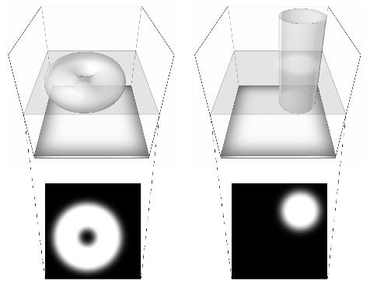
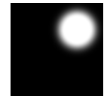



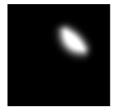
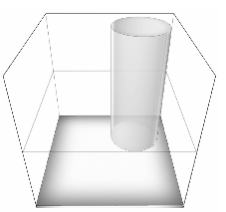
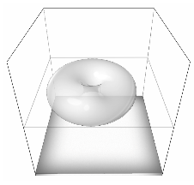
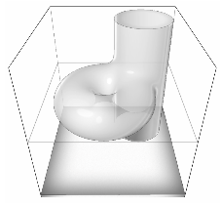
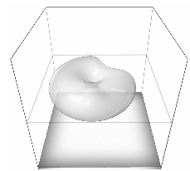
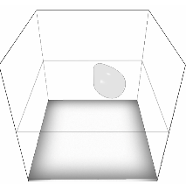
destination
source
volumetric model
2D-slice
destination channel after blending
blendmethod | mix | mix | mix | mix | multiply
dstalpha | 0 | 1 | 1 | 1 | n.a.
srcalpha | 1 | 0 | 1 | -1 | n.a.

